Slide 1
Lab 2:Majority Encoder
Sami Elias
Joseph popoviciu

Slide 2
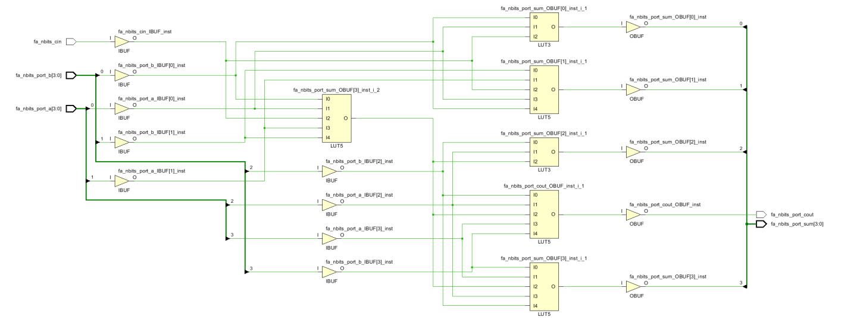
Objective
Create a majority encoder using verilog.

Slide 3
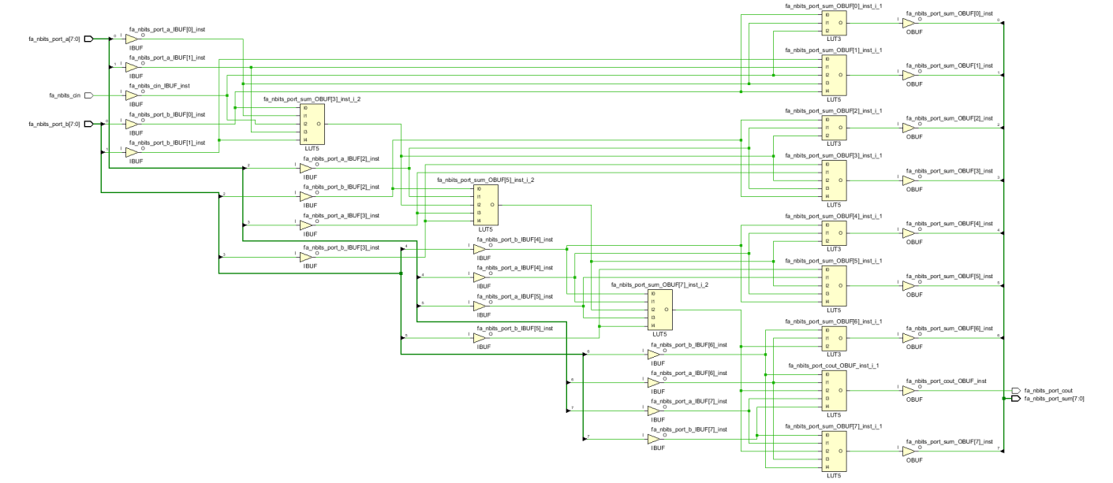
Objective cont.
Practice instantiating
Blocks.
Use structural
Modeling with data
flow

Slide 4
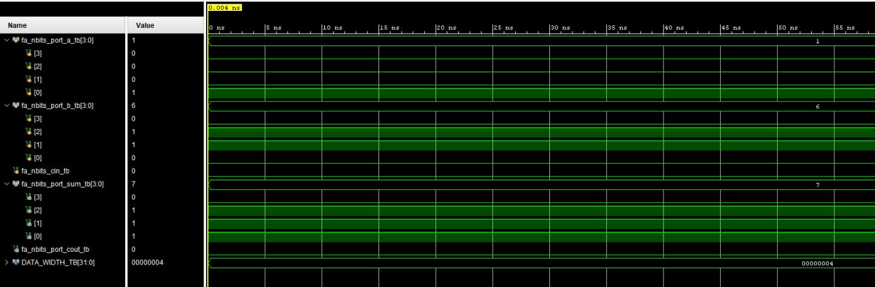
Test bench

Slide 5
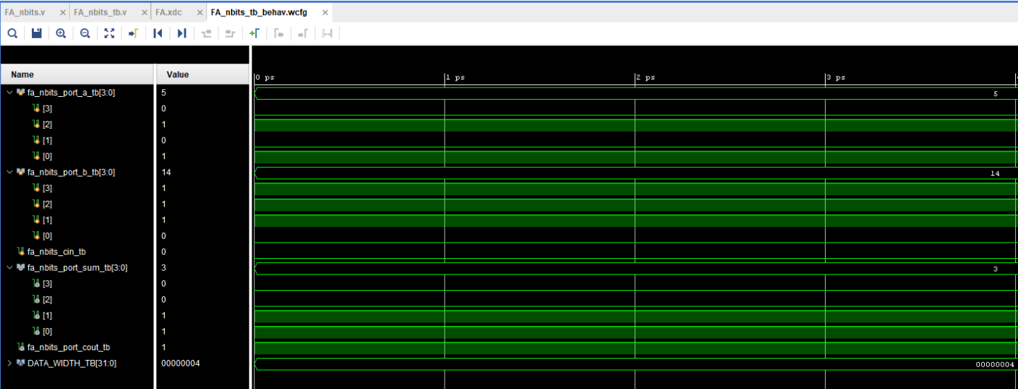
Test bench cont.

Slide 6
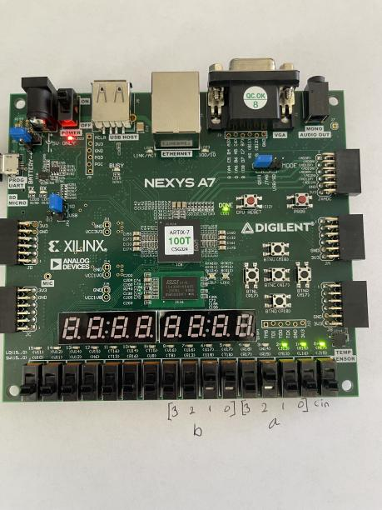
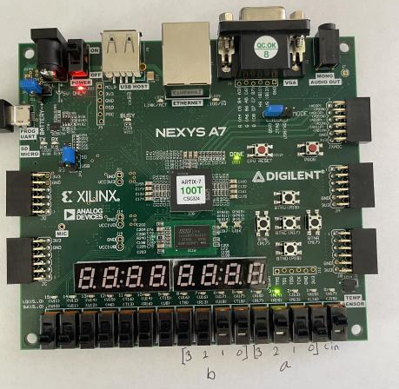
Results left image shows 0100+0011 and right image shows it with a carry in of 1

Slide 7
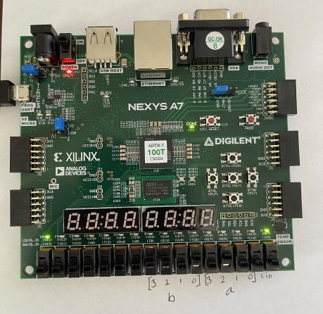
Results cont.
We also showed a carry out function.
This is 1101+0100 which returns 0001
With a carry out of 1.

